Slide 1
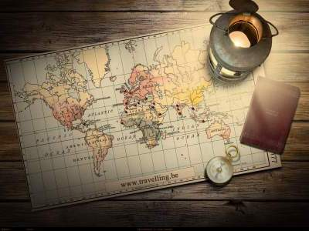
‘You will never know the world completely unless you travel’
Carolina Fonseca Píriz
Colegio Giner de los Ríos
2014-15

Slide 2
Whether or not
Unless
As long as
Different Conditional Structures
In case
But for
Only if/ if only

Slide 3
Unless: We use ‘unless’ to say ‘except under the following circumstances’ or ‘except if’. It sometimes means the same as if… not.
E.g. Unless you pass your English exam, your parents won’t allow you to go out on Saturday.

Slide 4
Only if, if only: We use ‘only if’ to emphasise an especial condition.
E.g. You can go only if you are back by midnight.

Slide 5
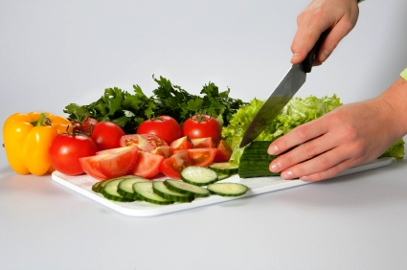
In Case: we use ‘in case’ to talk about things that we do before anything else happens in order to be prepared for future situations.
E.g. In case my sister is hungry when she comes, I will prepare a salad.

Slide 6
Whether or not: We can use ‘whether’ when there are options or when one of the options is the negative of the other.
E.g. I love soup whether it’s hot or cold.
I love soup whether it’s hot or not.

Slide 7
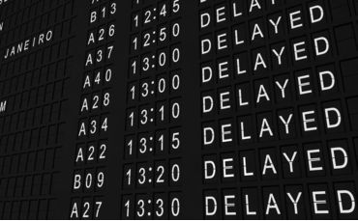
But for: it is used to mean ‘except for’.
E.g. They would have arrived on time but for the trains’ delay.

Slide 8
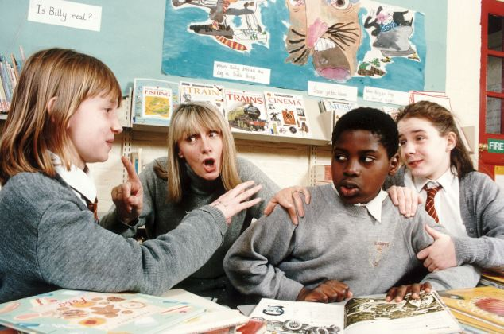
As long as: we use ‘as long as’ to say that one thing is true or will happen only if another thing is also true or will also happen.
E.g. You will go to the trip as long as you behave in class.

Slide 9
Complete the following sentences:
whether
Paul should drink milk ……………. he likes it or not.
They will buy a map .....………….. they get lost.
You can use my mobile pone …………………………. you use it carefully.
Mary will travel to Seville ………………………….. she has money enough.
Sophie couldn’t have finished her homework ……………. Nuria’s help.
…………… the train is delayed, I won’t have to wait in the station for a long time.
in case
as long as
only if/ as long as
but for
Unless

Slide 10
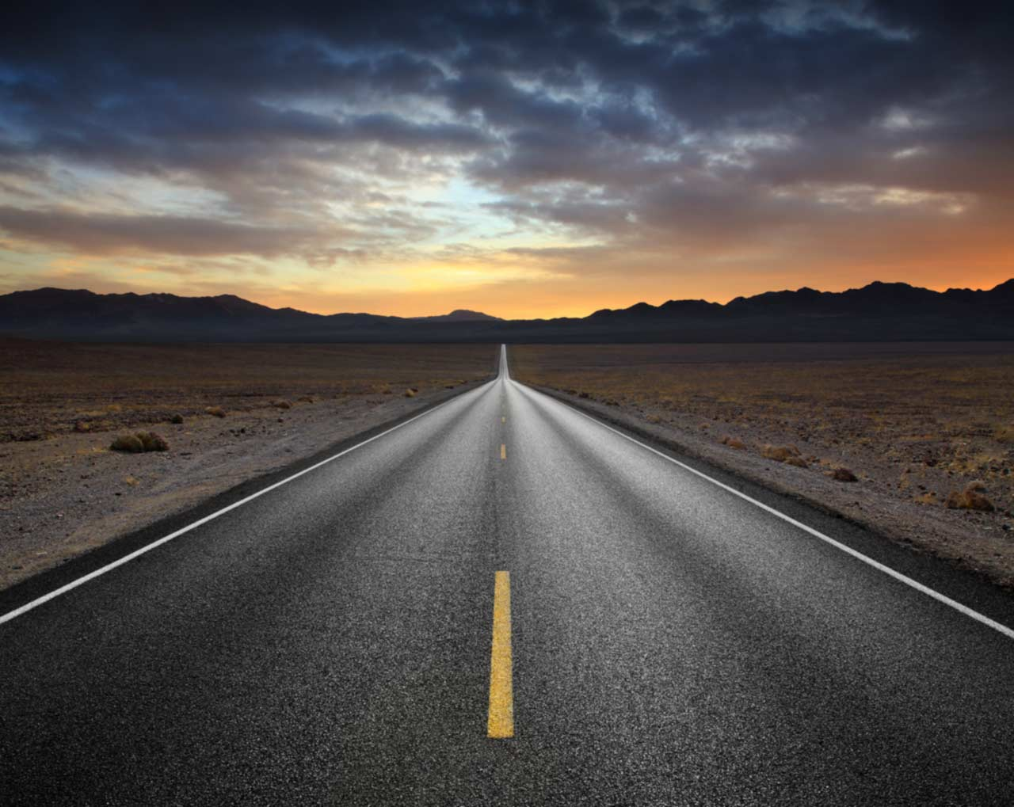
Travel
How do you get from point A to point B? I've heard some who like to travel by boat. Or maybe you like to float like a bee? Like a chihuahua in somebody's tote? I've seen folks who like to walk very slow. They carefully step each step with full care. As if they have a large burden in tow. (For those behind them it isn't quite fair...) Then there are those who enjoy going fast. To them there aren't enough hours in a day. They need to make ground for each moment passed. "Time is money!" -- At least that's what they say. Whether you travel by boat or by plane. All I care for is to see you again!

Slide 11
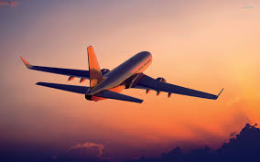
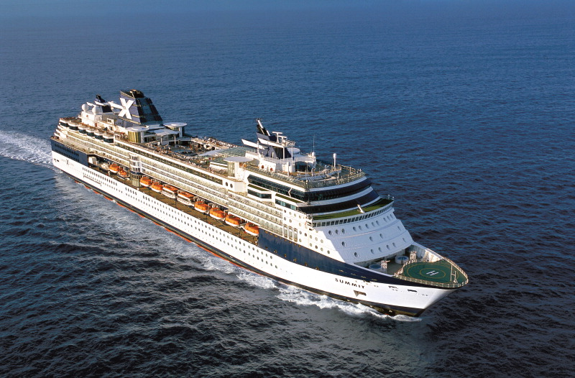
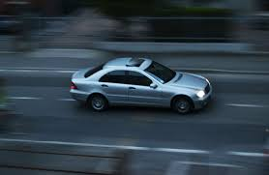
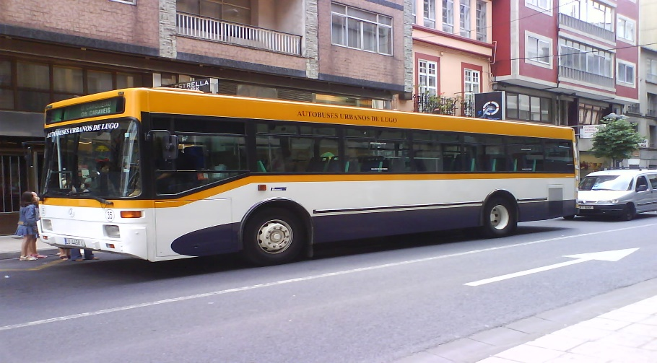
Travelling – Means of Transportation
A)
B)

Slide 12
Comparing and Contrasting Images.
Introduce at least one condition (zero, first, second, third or a different conditional structure)
Advantages and disadvantages of each picture. Ideas:
Cost, place, number of people, travel, time, comfort, possible problems, environment …
Comparing:
In the first picture … while/ whereas in the second picture.
The difference betwwen them is that…
The similarity between them is …
One thing that makes them similar/ different is …
On the one hand, on the other hand …

